Slide 1

FORGET ABOUT FORGETTING
An Introduction to Spaced Repetition
Notes:
Aaron Chu and Roger Craig (Jeopardy Champions) both quoted as using Anki extensively.

Slide 2
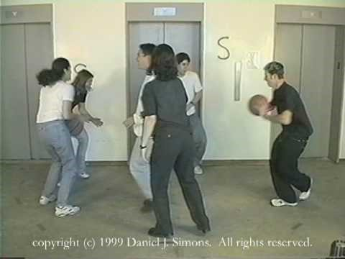

Slide 3

HISTORY
Or: OLD ACADEMICS FIGURE STUFF OUT
FORGET ABOUT FORGETTING

Slide 4
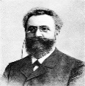





1885
Hermann Ebbinghaus
FORGET ABOUT FORGETTING
Notes:
For millennia, before, no serious object study of memory
Determined to do just that

Slide 5
1885
DAX
HOT
FOS
BOL
YAT
HAL
BOK
FORGET ABOUT FORGETTING
Notes:
Prior knowledge affects learning – so he studied “nonsense syllables” (CVC trigrams)
Syllables with a relationship to real words (HOT, HAL) omitted for similar reasons
he would pull out a number of random syllables from a box and then write them down in a notebook. Then, to the regular sound of a metronome, and with the same voice inflection, he would read out the syllables, and attempt to recall them at the end of the procedure. One investigation alone required 15,000 recitations.

Slide 6
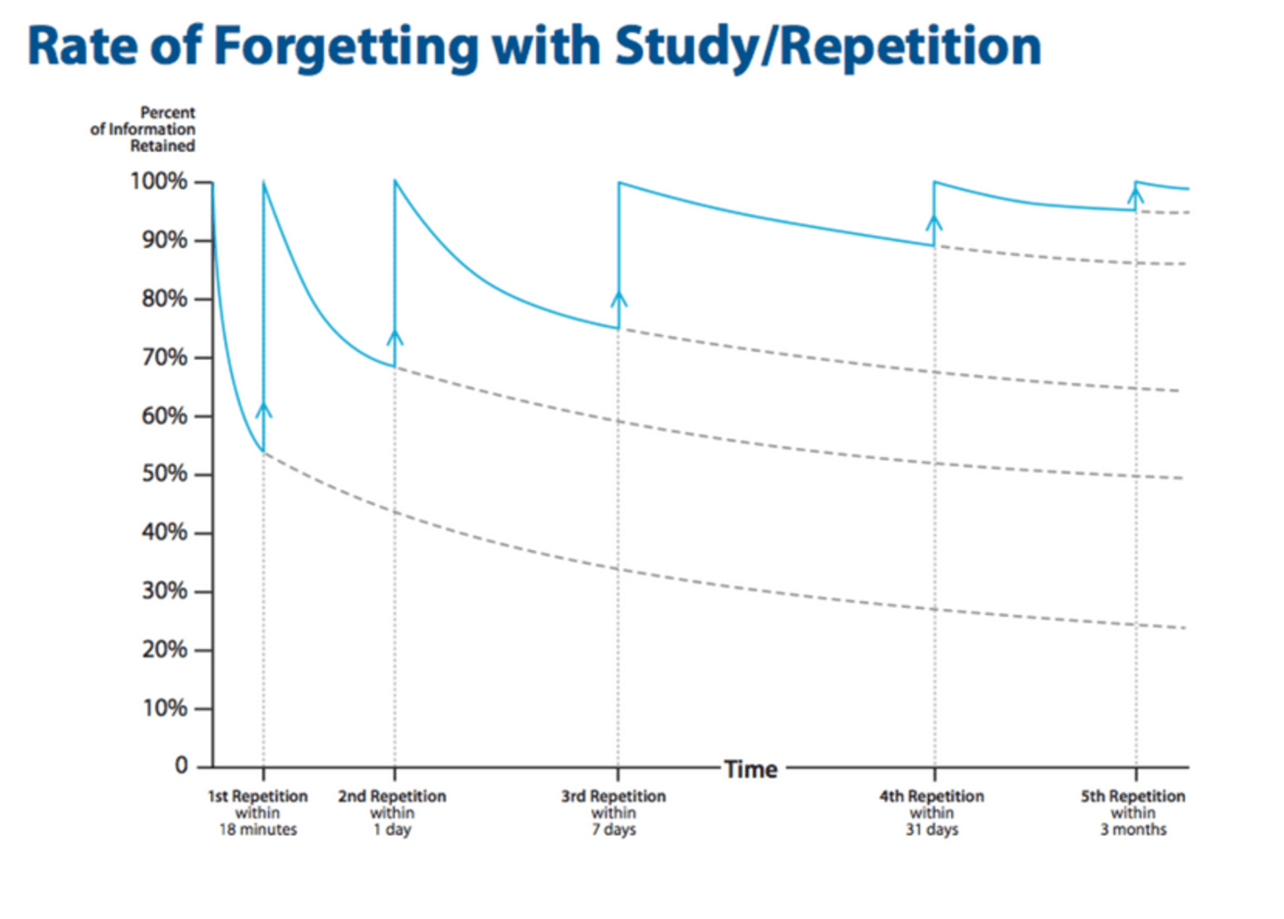
1885
Forgetting Curve
Learning Curve
FORGET ABOUT FORGETTING
Notes:
Wrote a book about his findings Uber das Gedachtnis (geh-dake-nis)
First described forgetting and learning curves (didn’t coin learning curve)
The familiar expression "a steep learning curve" is intended to mean that the activity is difficult to learn, although a learning curve with a steep start actually represents rapid progress.
Unfortunately sample size of studies was one (himself)

Slide 7

1973
Sebastian Leitner
FORGET ABOUT FORGETTING
Notes:
German science journalist Sebastian Leitner –
So lernt man lernen – (How to learn to learn)
Leitner system
No picture found, so here’s an artist’s rendering

Slide 8
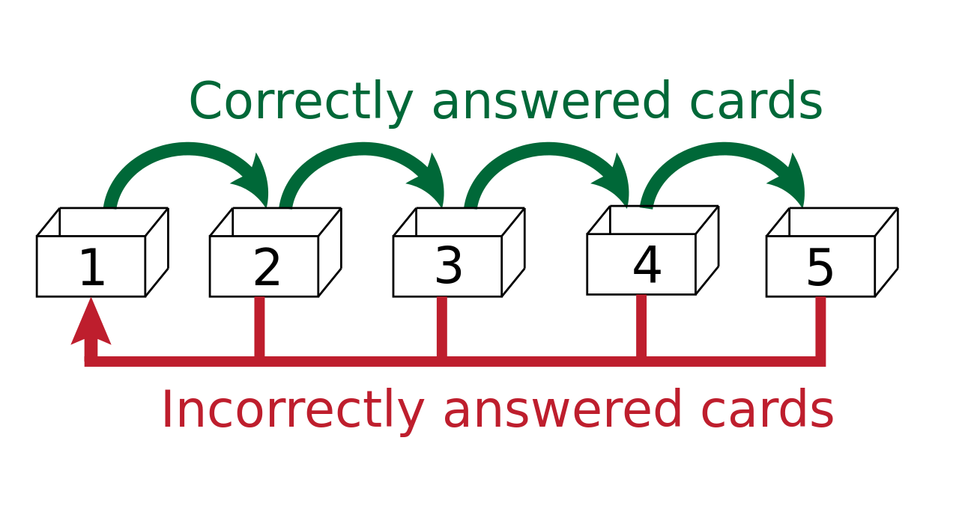
1973
FORGET ABOUT FORGETTING
Notes:
Explain system
The advantage of this method is that the learner can focus on the most difficult flashcards, which remain in the first few groups. The result is, ideally, a reduction in the amount of study time needed.
1 3 5 10 30
How do you pick intervals well? We’ll revisit in a moment

Slide 9
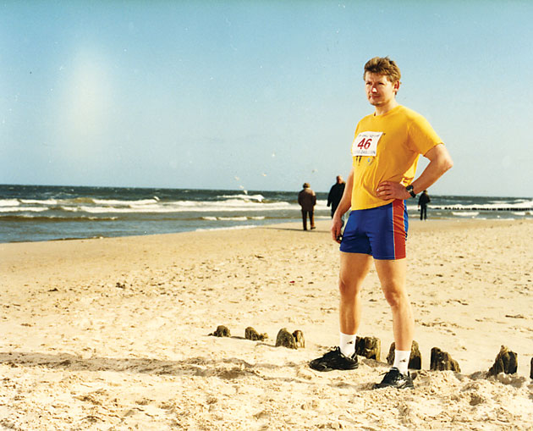
1980’s
PIOTR WOZNIAK
FORGET ABOUT FORGETTING
Notes:
Pee-oh-trah
As I’m sure many of us can relate, became frustrated by sheer volume of information college expected you to memorize.
Obvious conclusion - active recall - the process in which pieces of information are actively retrieved from memory as opposed to passive review. For example, in passive review one might read that the highest divorce rate occurs in the 4th year of marriage. In active recall, you would have to retrieve this information from your memory: In which year of marriage are couples most likely to divorce? If you answer correctly, "4th year", then your memory stability will increase and so will the probability of recall in the future. In passive review, this increase is dramatically less pronounced.
Starts making flash cards, logging review results/dates meticulously.
Independently comes to similar conclusions as Leitner and Ebbinghaus; he writes a very simple SuperMemo 1.0 for MS DOS in Borland's Turbo Pascal 3
Several iterations by end of 80’s
Computer power allows introduction of E(ase) factor to system (dynamic intervals per fact). Also allows better projection of forgetting curve
Eccentric – given all time management over to computers, even incremental reading for emails (respond to different parts of an email at different times based on priority)

Slide 10
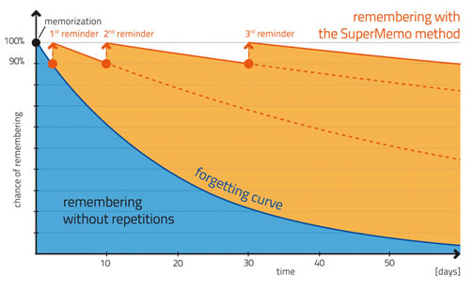
1980’s
FORGET ABOUT FORGETTING
Notes:
Note repetitions/reminders try to happen at same % chance of remembering every time.

Slide 11

1992
Robert Bjork
FORGET ABOUT FORGETTING
Notes:
Robert Bjork – New Theory of Disuse – Two characteristics for quantifying memory recall - Storage strength and Recall Strength
Looks like the eyes of a man who can’t forget

Slide 12
1992
Bjork’s New Theory of Disuse
Your College
Dorm Address
Your Birthday
Storage Strength
This Presentation
New Coworker’s Name
Retrieval Strength
FORGET ABOUT FORGETTING
Notes:
Storage strength is a general measure of how well learned that item is. Increases monotonically (with more exposure) and does not have a direct effect on memory performance; the probability that you will be able to reproduce something from memory (e.g., a name or phone number) depends almost entirely on its retrieval strength, which measures how accessible the item is at that time. varies with context and intervening information. what we need to increase if we want to be able to remember an item later.
Birthday, college, coworker, presentation
Fortunately, the new theory of disuse proposes a way to do just that: the very act of retrieving an item from memory has a potent effect on its retrieval strength! Note that retrieving is different than studying—in order for retrieval strength to be boosted the most, you need to come up with the item yourself. The real kicker—and where forgetting comes in—is that the more difficult the retrieval is, the more beneficial it will be when you finally do come up with the answer! Thus, the more you forget something, the better you can ultimately remember it. This is part of the idea behind interleaving (alternating topics to learn as in ABCABC instead of AABBCC) and spacing (spreading out study sessions instead of marathon studying)—you need to give yourself time (or, more accurately, some amount of interfering information) to aid forgetting so that you get the most benefit from a retrieval.
Basically, The New Theory of Disuse describes interesting ways in which RS and SS interact. With the above example of a childhood address where SS was high and RS was low consequent restudy gives a huge boost to RS. Whereas the opposite is true where SS is small and you keep restudying a topic so the RS is high. A prime example would be rote learning a list of facts, simply repeating to-be-learned information over and over again is not very helpful. You need to form deeper connections to improve long-term retention.
So studying things just around the time of forgetting them is optimal.
Supermemo rolled this concept into algorithm.

Slide 13
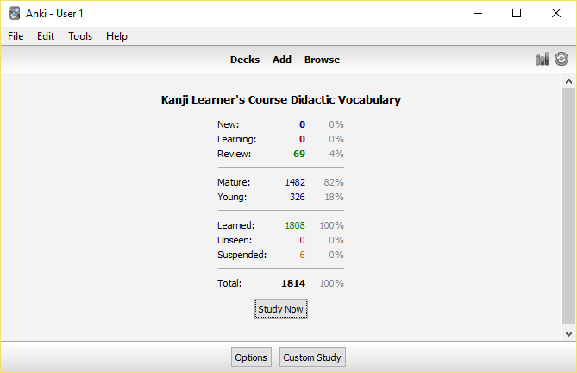
2006
ANKI (Software)
FORGET ABOUT FORGETTING
Notes:
Anki – 2006 (to provide an idea of recency) Damien Elmes
Uses one of the supermemo algorithms; highly customizable, available on PC, iOS, android, web, etc (game changer for me)
Discuss more details later, but first, let’s summarize the pro’s and con’s of spaced repetition.

Slide 14
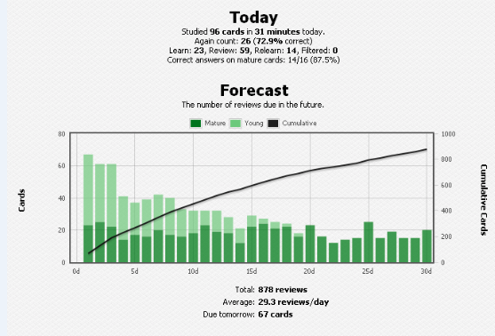
2006
ANKI (Software)
FORGET ABOUT FORGETTING

Slide 15
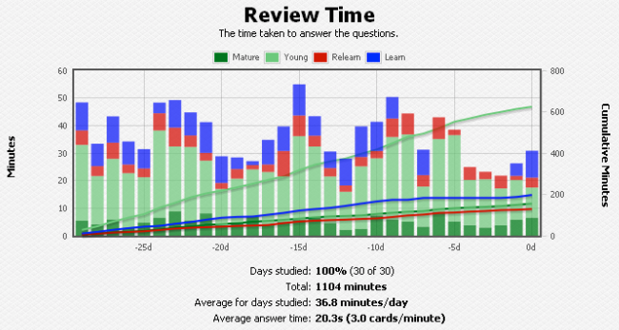
2006
ANKI (Software)
FORGET ABOUT FORGETTING

Slide 16
PROs and Cons
Or: Spaced Repetition isn’t Magic
FORGET ABOUT FORGETTING

Slide 17
Pros
Hundreds of pre-made flashcard decks
Memorize massive amounts of information (and do it well / increase both RS & SS)
Efficiently use your study time *
FORGET ABOUT FORGETTING
Notes:
Specifically talking about SRS now, not just the concept.

Slide 18
CONS
Snowball Effect
Not suited to short intervals (it’s a long term strategy)
FORGET ABOUT FORGETTING
Notes:
Specifically talking about SRS now, not just the concept.

Slide 19
USING SRS EFFECTIVELY
Or: MAKE YOUR OWN DARN FLASHCARDS
FORGET ABOUT FORGETTING

Slide 20
UNDERSTAND FIRST
FORGET ABOUT FORGETTING
Notes:
Read a book’s chapter and only once you have digested it should you create flashcards from it.
As Piotr (pee-oh-trah) Woz says, you can memorize a German language history book without speaking German, but why would you? This extreme example illustrates the point.
(and yes, this is the only picture of him I could find. There’s a polish minister of economy of the same name)

Slide 22

Make your own deck
FORGET ABOUT FORGETTING
Notes:
You can’t trust others’ materials as much as something you made yourself. You don’t want to spend months learning material perfectly only to find out it’s wrong.
Making the deck yourself helps cement your understanding (and as just discussed, that’s very important)
This is more of a judgment call.

Slide 23
MINIMUM INFORMATION PRINCIPLE
RMS Titanic was a British passenger liner that sank in the North Atlantic Ocean in the early morning of 15 April 1912, after colliding with an iceberg during her maiden voyage from Southampton to New York City. Of the 2,224 passengers and crew aboard, more than 1,500 died in the sinking, making it one of the deadliest commercial peacetime maritime disasters in modern history.
FORGET ABOUT FORGETTING
Notes:
The more you can simplify something, the easier it is to remember. Break information into the smallest digestible chunks.
(example sentence)

Slide 24
MINIMUM INFORMATION PRINCIPLE
What date was the Titanic’s maiden voyage? 15 April 1912
Where was the Titanic sailing from and to? From Southampton to New York City
How many passengers and crew were aboard the Titanic? 2,224
How many passengers died in the sinking of the Titanic? 1,500
FORGET ABOUT FORGETTING
Notes:
All the memories are now small facts that can be scheduled for review independently of each other.

Slide 25
Recall versus recognition
15 April 1912 was the maiden voyage of what boat?
What boat’s maiden voyage was from Southampton to New York City?
On it’s maiden voyage, this boat had 2,224 passengers and crew onboard.
1,500 passengers died in the sinking of this boat.
FORGET ABOUT FORGETTING
Notes:
Recall and recognition are very different memories.
Obviously, this is a contrived example, but if we were trying to study dozens (or hundreds) of famous shipwrecks, because ostensibly that’s the information you want to learn, testing things like this would be worthwhile.

Slide 26
Tap into Your reptile brain
P.E.M.D.A.S.
FORGET ABOUT FORGETTING
Notes:
Build your memories around visual, auditory, and emotional mnemonics rather than abstract ideas or rote memorization whenever possible.
The hallmark of a good mnemonic is eliciting that visualization or emotional reaction.
Pranksters Earn Math Detention After School
Push Eryn Matthews Down A Sewer

Slide 27
Tap into Your reptile brain
E.B.G.D.A.E.
FORGET ABOUT FORGETTING
Notes:
Easter Bunny Gets Drunk At Easter
Every Beautiful Guitar Deserves Amps Everyday

Slide 28
Combat memory interference
汗をかく
ase wo kaku
発汗する
hakkan suru
To sweat, to perspire
To perspire, to sweat
??????
FORGET ABOUT FORGETTING
Notes:
If you start building a substantial deck of memories, you will inevitably start to come across similar cards that trip you up. For example, in Japanese I eventually realized I had these two cards in my deck.
Very different in Japanese, but the English definition was almost identical!
Remembering simply by the order does not yield a good memory.

Slide 29
Combat memory interference
汗をかく
ase wo kaku
発汗する
hakkan suru
To sweat
To perspire
[medical terminology]
FORGET ABOUT FORGETTING
Notes:
If you start building a substantial deck of memories, you will inevitably start to come across similar cards that trip you up. For example, in Japanese I eventually realized I had these two cards in my deck.
Very different in Japanese, but the English definition was almost identical!
Remembering simply by the order of the definition does not yield a good memory.

Slide 30
IN SUMMARY …
Understand what you want to learn first
Create your own flashcard deck
Put the minimum amount of information on each card
Recall and recognition are different memories
Use mnemonics and audio/imagery, esp. with an emotional connotation
Nip memory interference in the bud
FORGET ABOUT FORGETTING

Slide 31
LET’S DO IT!
Or: Recommended Software
FORGET ABOUT FORGETTING

Slide 32
SOFTWARE
Anki – General purpose, very customizable, many pre-made decks.
Memrise – Has language, trivia, and more “courses”. Gamified; go on learning “streaks” and earn points. Less customizable.
Duolingo – Languages only, very slick, persistent about reminders, great for romance languages.
SuperMemo – General purpose, arcane interface, but has the most modern SM learning algorithms. Supports incremental reading.
FORGET ABOUT FORGETTING
Notes:
Incremental reading isn’t as well studied as spaced repetition.

Slide 33
Further Reading
Wired article on SuperMemo and Piotr Wozniak
Collection of articles about memory and SuperMemo
Series of video interviews with Robert Bjork about a variety of topics
FORGET ABOUT FORGETTING

Slide 34
1885
1980’s
2006
1973
1992
FORGET ABOUT FORGETTING

